Slide 1

TPS Reporting’s Final Presentation
Team Leader: Nicholas Alcorn
Other Members: Trevor Bal, Carl Moon II, Yasmina Rabhi, & Cameron Randolph

Slide 2
Iterations
Sprint #1: Design and implementation of login page, login servlet, and database update.
Sprint #2: Create business logic objects and object Junit tests.
Sprint #3: Design and implementation of “Form Creation” page, creation of “Body check” form, and persistence servlet.
Sprint #4: Creation of “Incident Report” form, and persistence servlet. Began form conversion to PDF format.
Sprint #5: Create “Form Retrieval” page and create servlet for dispatching to “Create Form” page and populate data for editing.
For further information, refer to next slide.

Slide 3
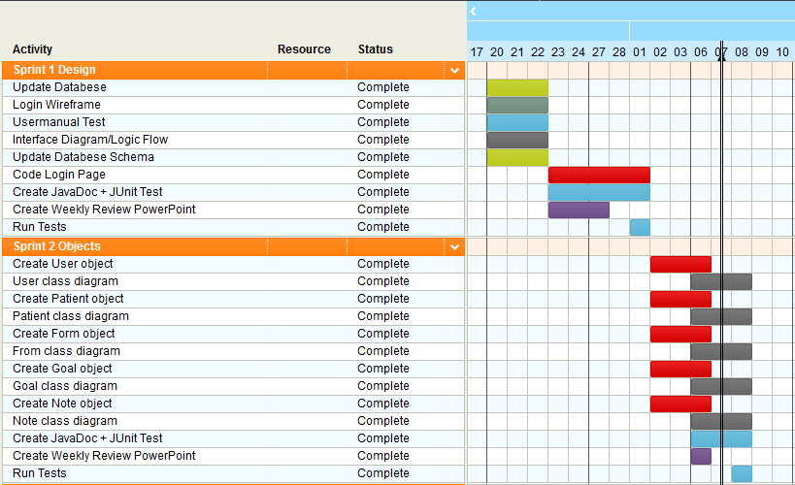

Project Management

Slide 4
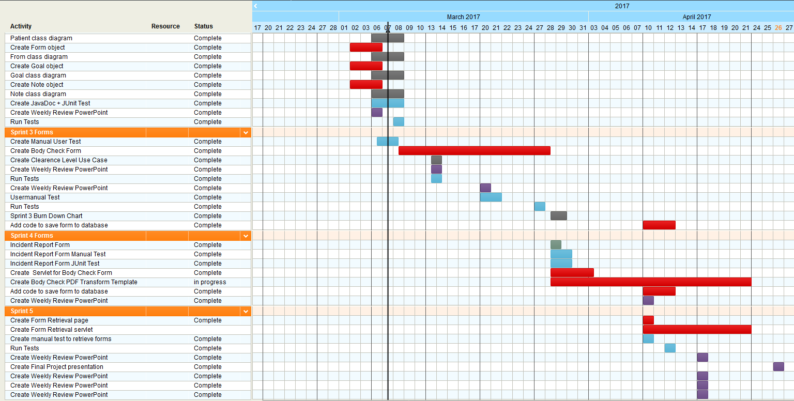
Project Management (Continued)

Slide 5
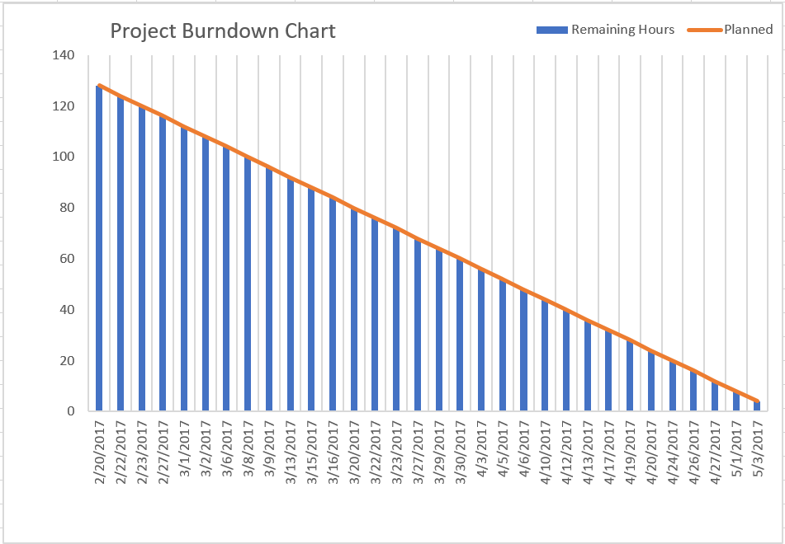
Project Management (Continued)

Slide 6
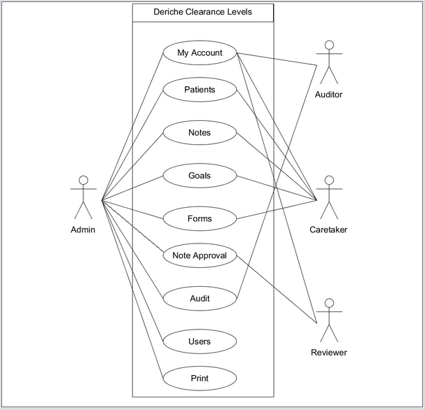
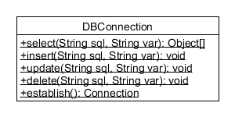
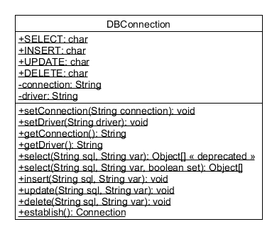
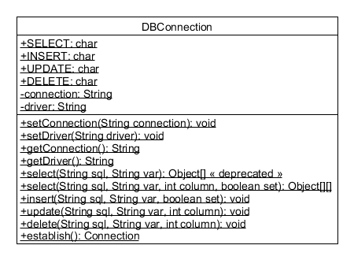
Diagrams

Slide 7
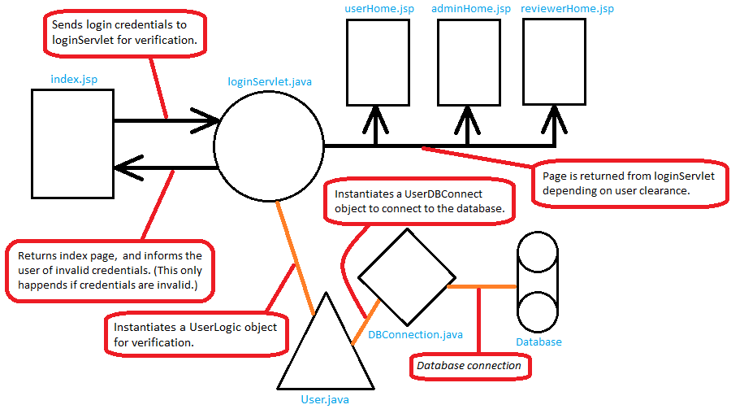
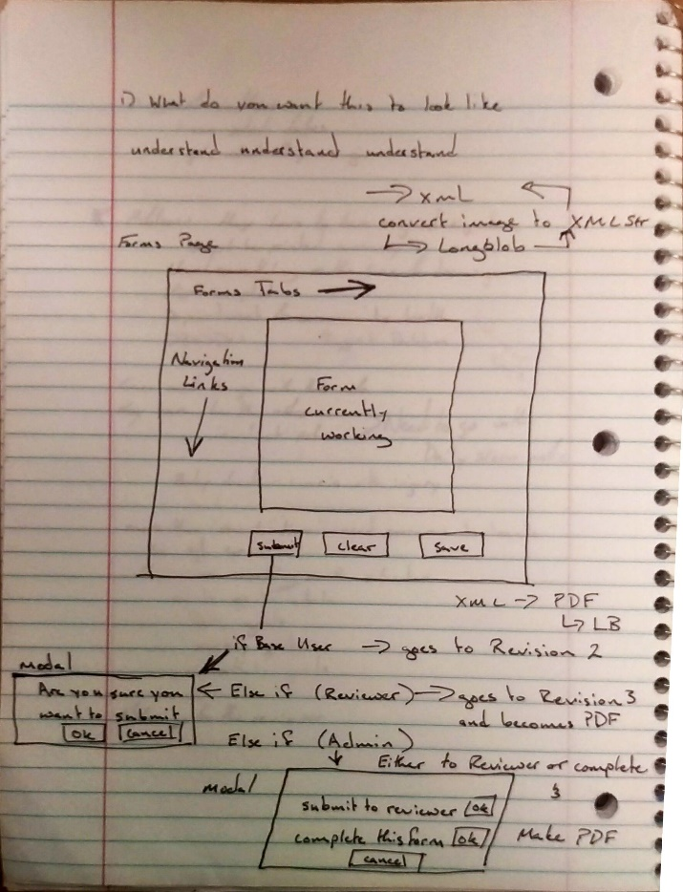
Diagrams (Continued)

Slide 8
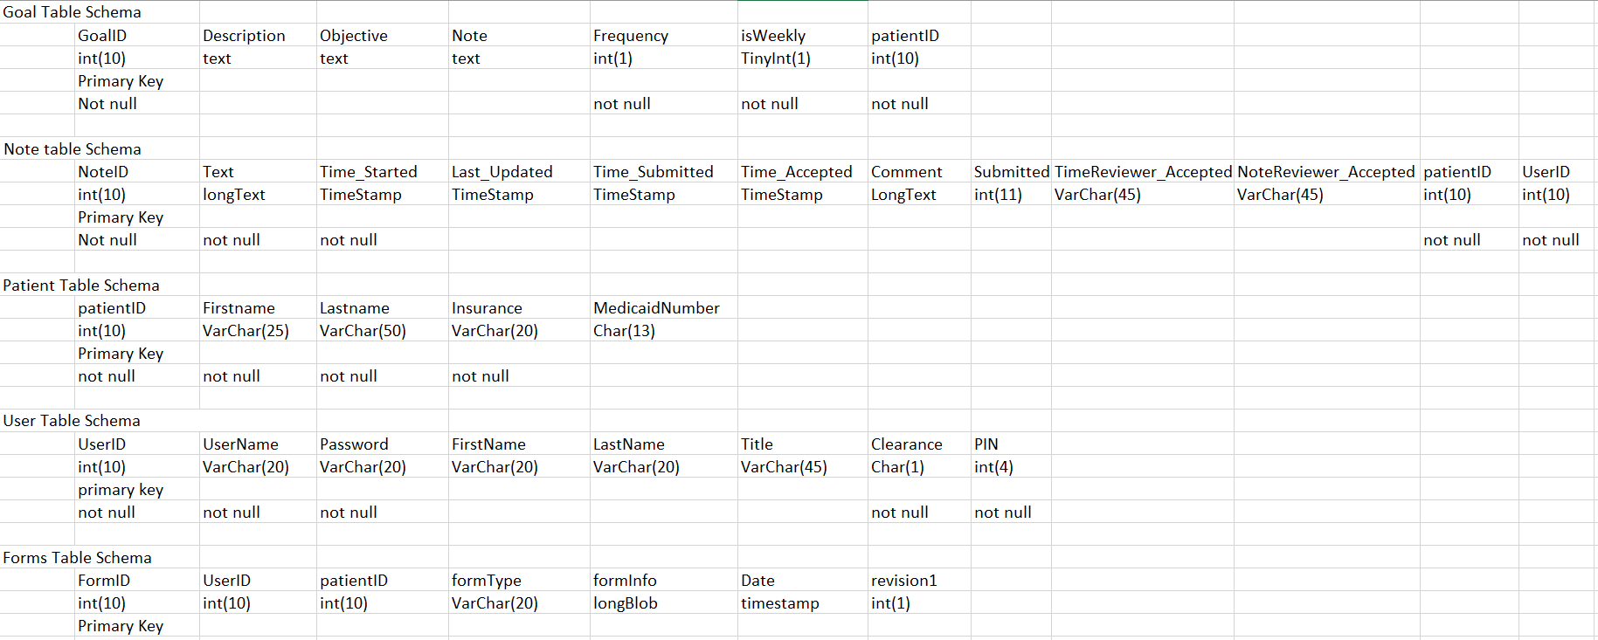
Database (Schema)

Slide 9
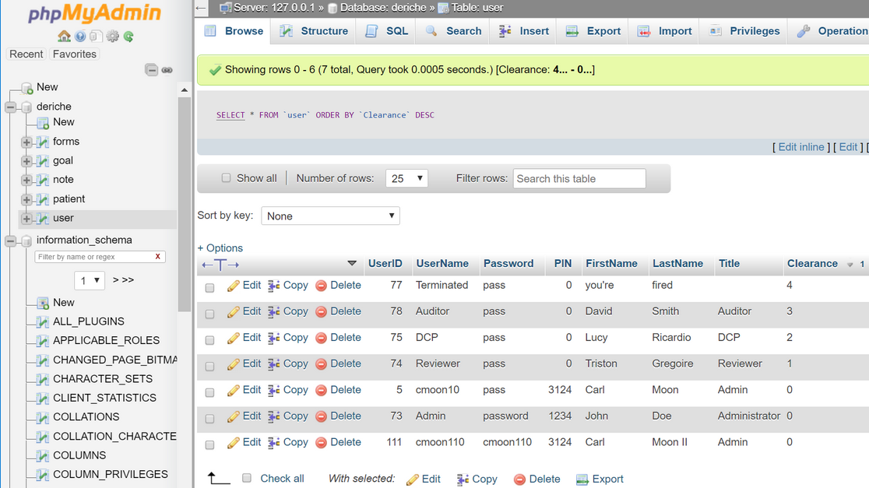
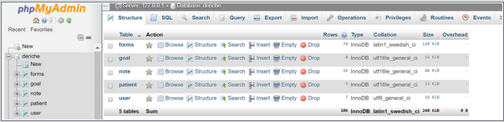
Database (Deployed)

Slide 10
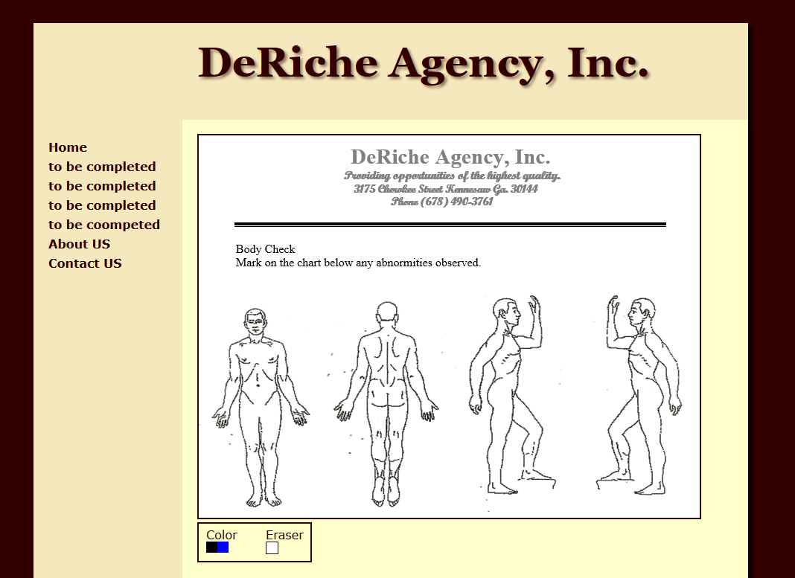
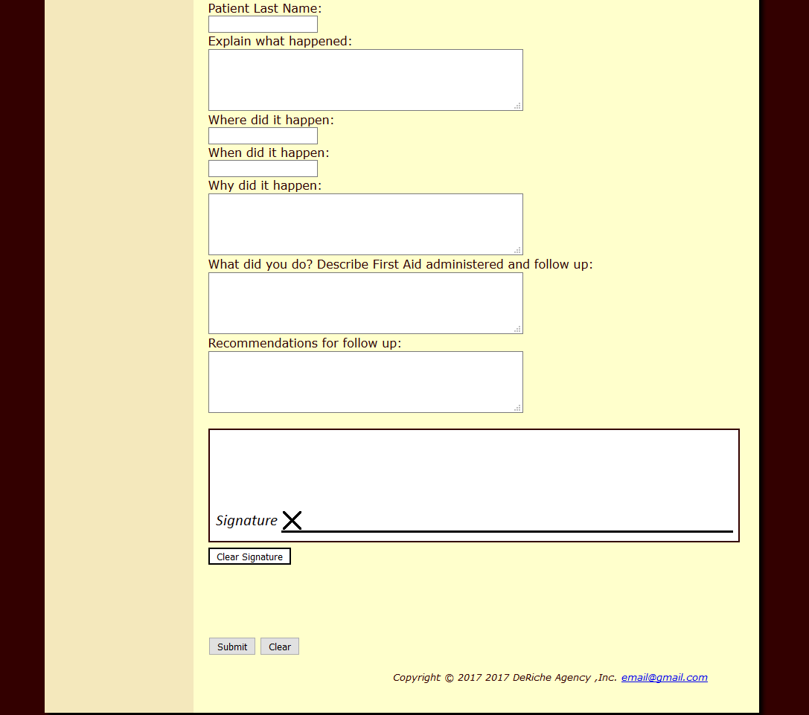
Interface Design

Slide 11
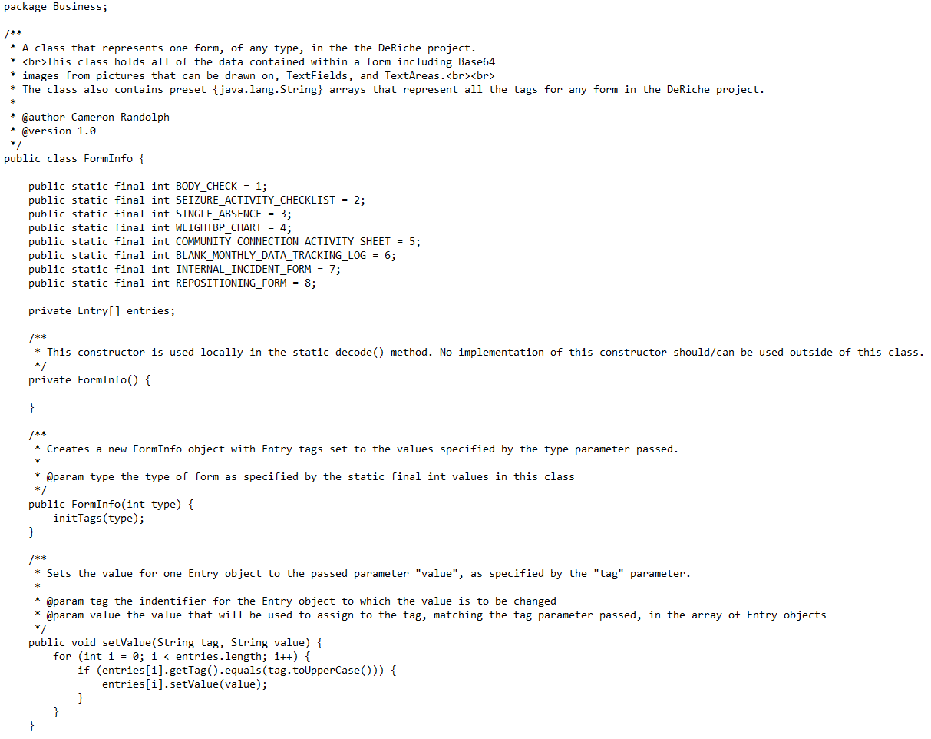
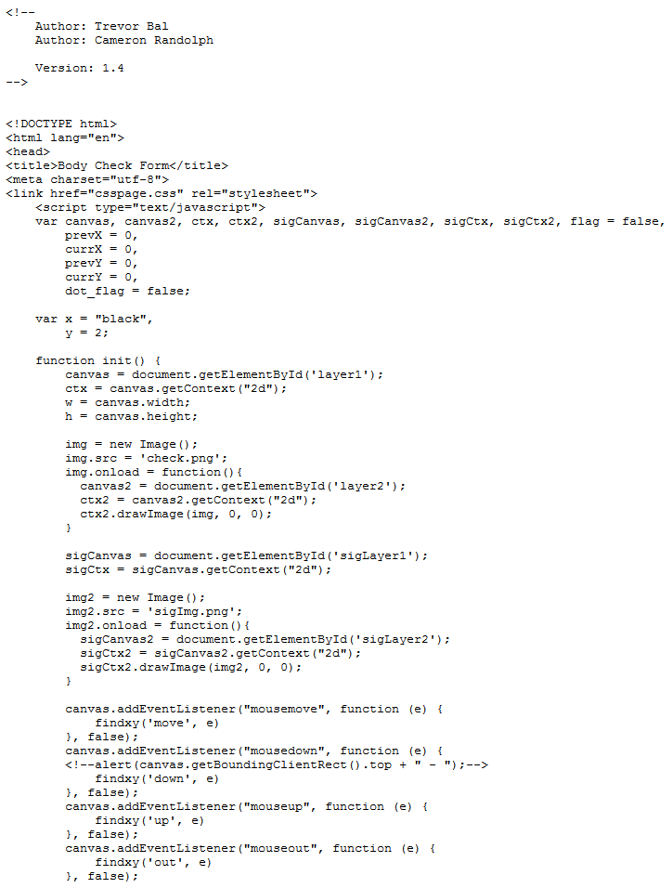
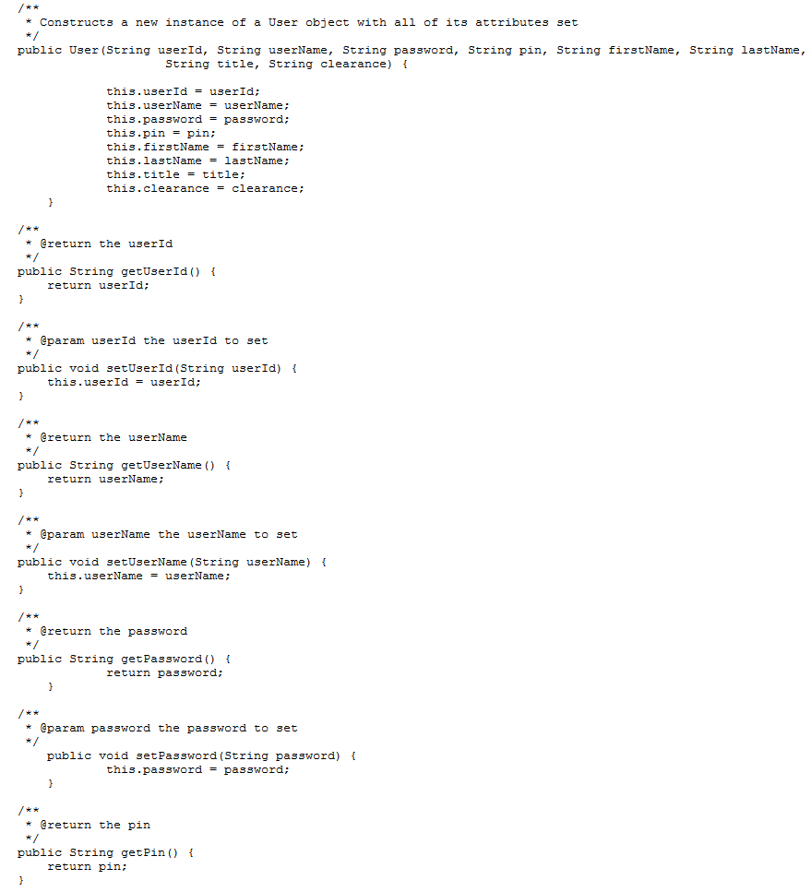
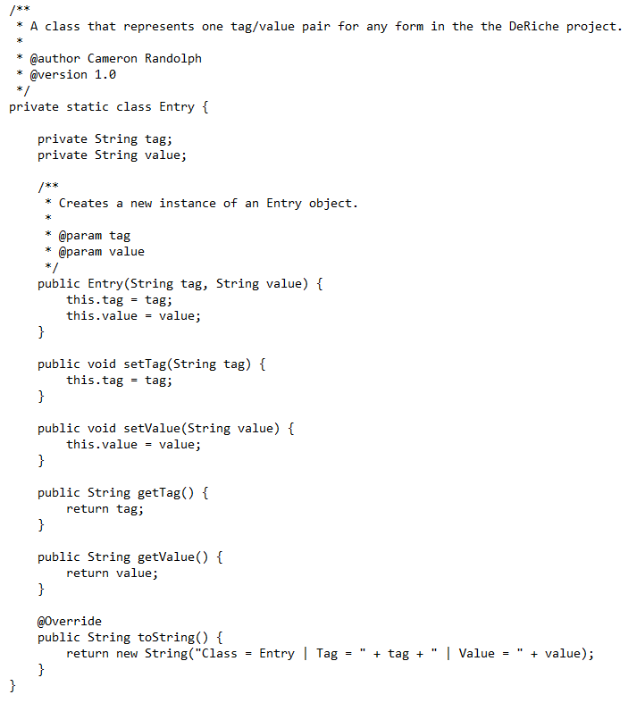
Running Code

Slide 12
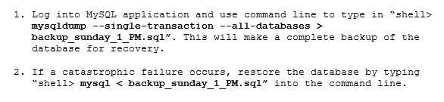
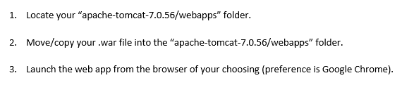
Backups/Restore & Installation

Slide 13
Test Plan
To test for syntax and minor logic errors we used JUnit.
We created manual user tests to guide users step-by-step through each process (examples, “login”, “form creation”, and “form retrieval”), and provide informative feedback.
Refer to next slide for examples.

Slide 14
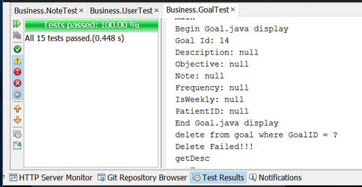
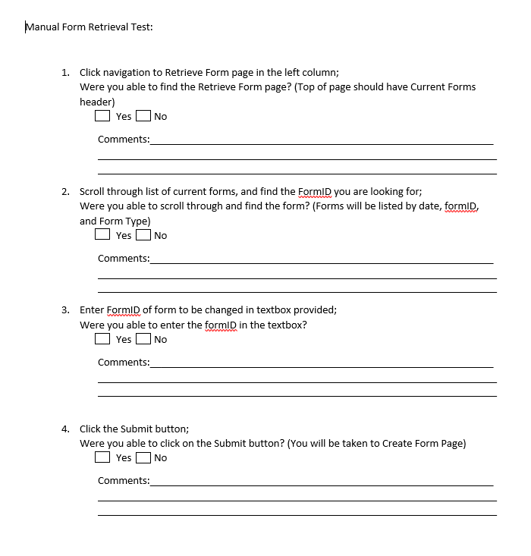
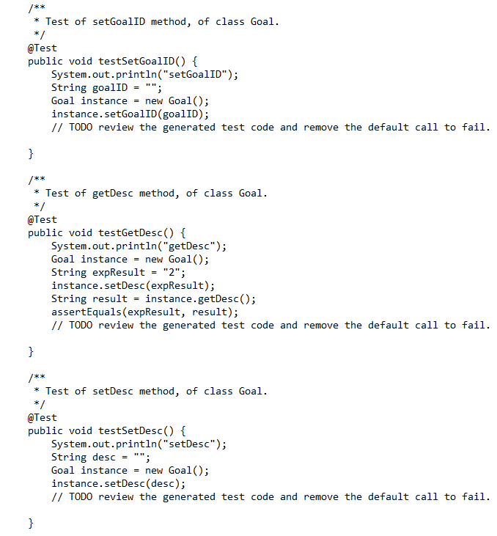
Test Examples

Slide 15
Documentation
We have created descriptive documentation for each method and class in the application.
Every comment block is formatted to be used with Javadocs.
Some extra files have been created to assist with more complicated implementations of abstract classes and interfaces.
Refer to next slide for examples.

Slide 16
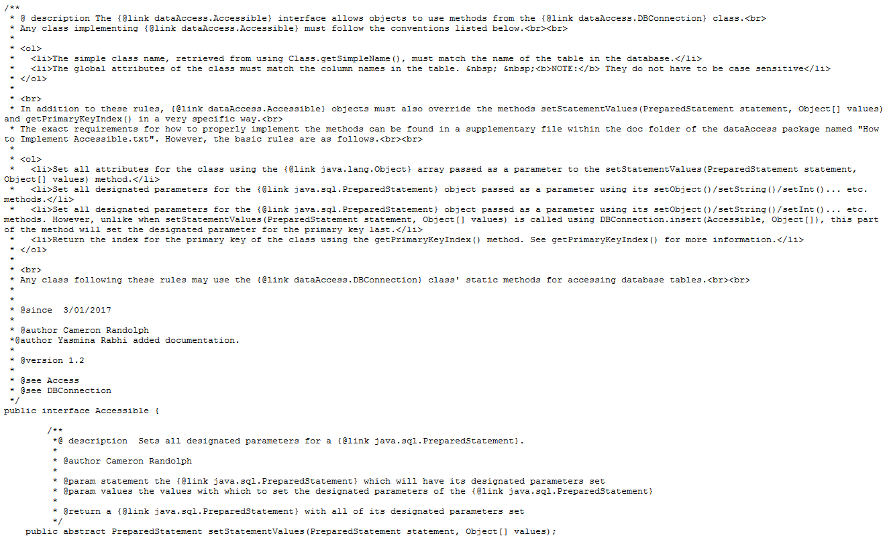
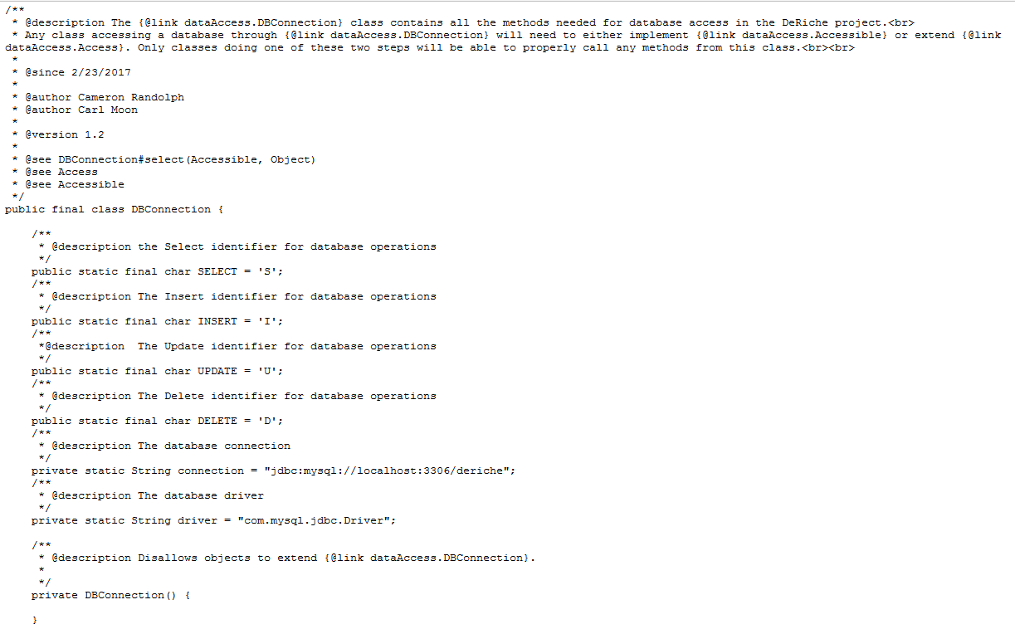
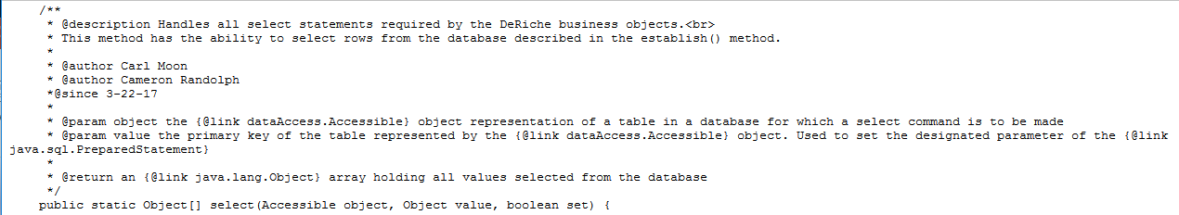
Documentation (Continued)

Slide 17
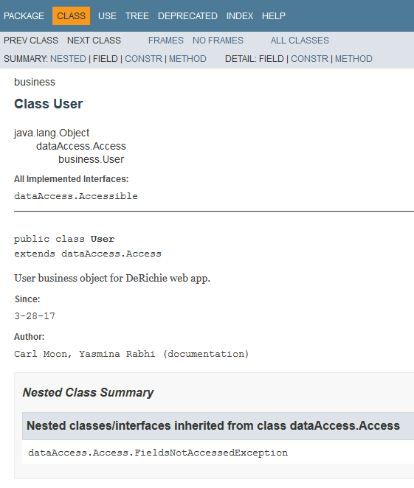
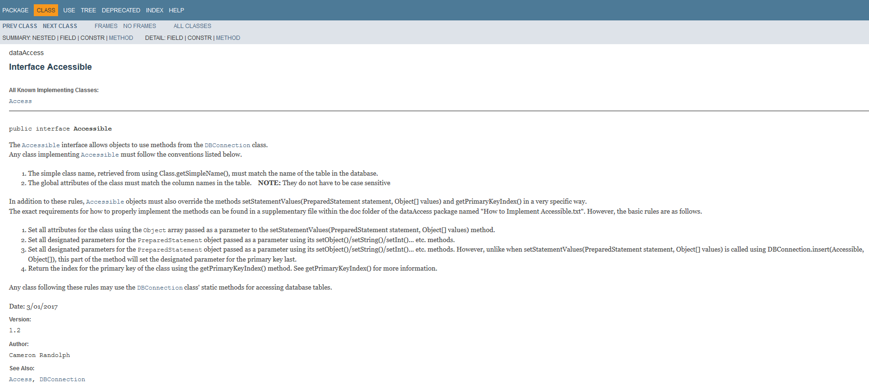
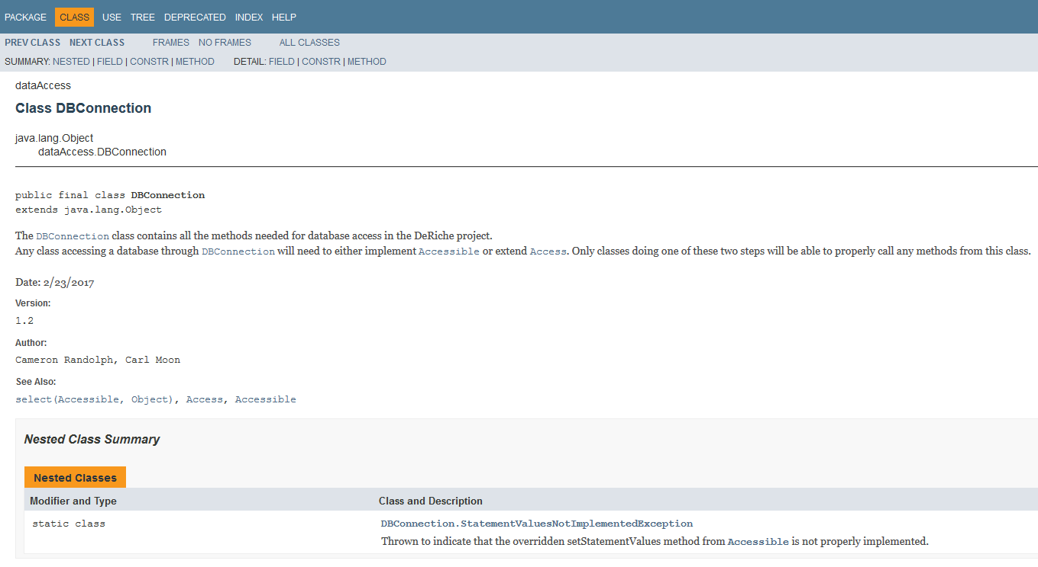
Documentation (Continued)

Slide 18
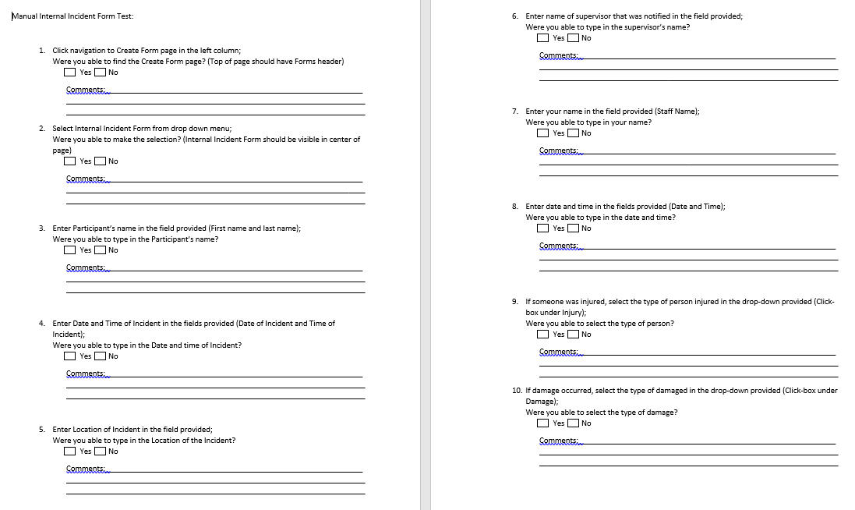
Documentation (Help Facility)

Slide 19
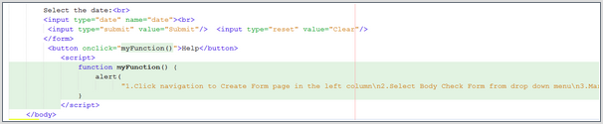
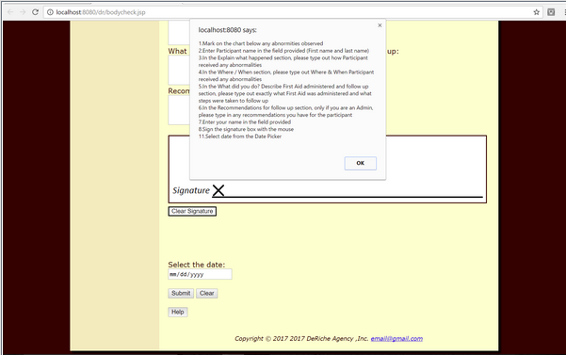
Documentation (Help Facility “in app”)

Slide 20
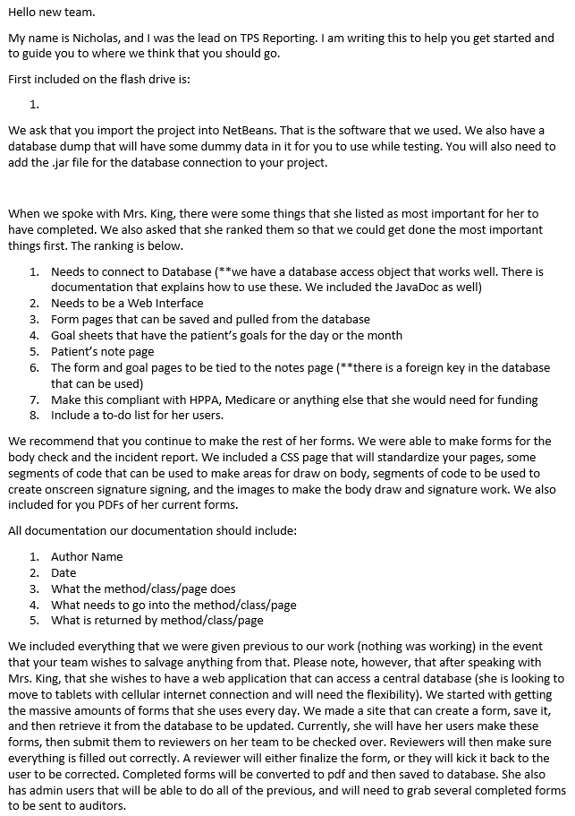
Documentation (Where/How to Start)

Slide 21
The Project!
Project Demo
Enjoy :3

